Slide 1
Network basics

Slide 2
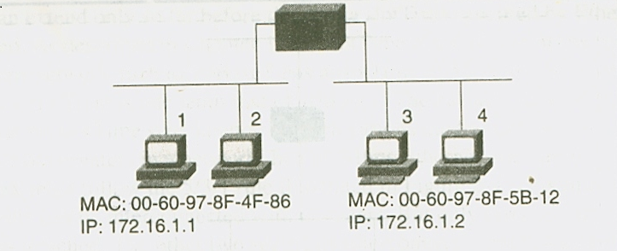
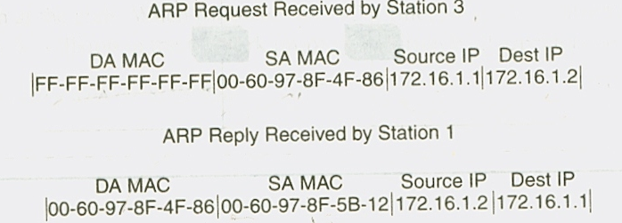
ARP ( Address Resolution Protocol )

Slide 3
Transparent bridging
IEEE 802.1d defines five bridging processes
Learning
Flooding
Filtering
Forwarding
Aging

Slide 4
Transparent bridging
When frame enters the bridge
Bridge adds the source MAC & source port to its bridge table
If source address already exists in the table, Bridge updates the aging timer
The bridge examines the destination MAC address (DA).
If the destination Mac address is unknown . The frame received is known as unknown unicast
If frame received is unknown unicast or broadcast or multicast , it floods,
if destination and source are on same interface, it filters otherwise it forwards

Slide 5
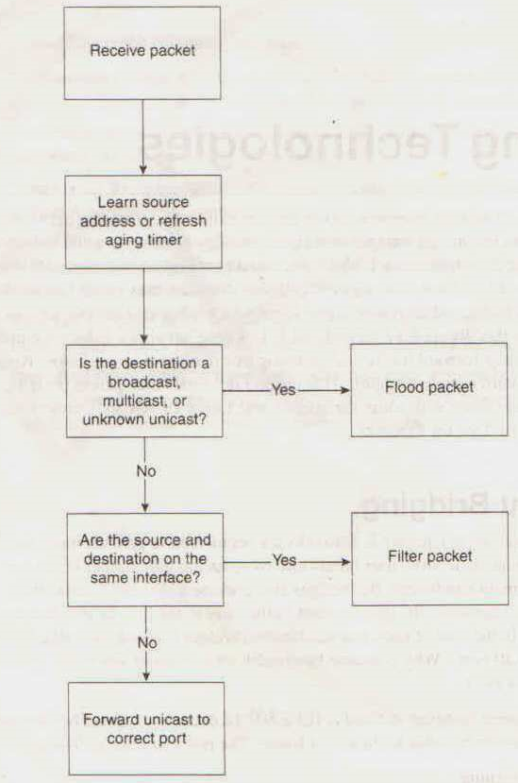
Transparent bridging flow chart

Slide 6
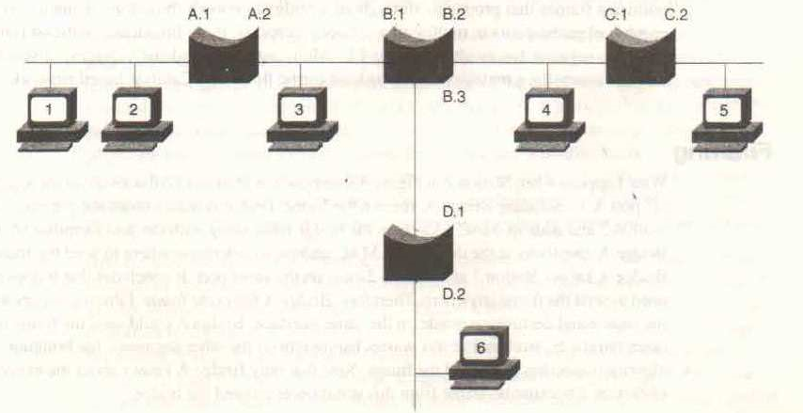
Sample bridge network

Slide 7
Learning
Each bridge has a table that stores the source MAC address & source port
Bridge learns only unicast source address
When bridge is switched on for the first time, it contains no entry

Slide 8
Sample bridge network

Slide 9
Learning
Station 1 transmits a uncast frame to station 2
Bridge A learns the MAC address of machine 1 at port A.1
Now bridge checks for destination address, it does not find the entry in bridge table. This frame is unknown unicast so it floods the frame on all remaining port
This causes all bridges to learn about machine 1
Bridge table indicates the relative location of the port
Bridges also flood broadcast & multicast frame
Bridge port | A.1 | A.2 | B.1 | B.2 | B.3 | C.1 | C.2 | D.1
Mac | 1 |  | 1 |  |  | 1 |  | 1

Slide 10
learning
When station 2 responds to station 1 .
All station on segment 1 including bridge A receive the frame
Bridge A learns the source address of station 2
Since bridge knows that station 1 exists on same segment , so it filters the frame
Bridge port | A.1 | A.2 | B.1 | B.2 | B.3 | C.1 | C.2 | D.1
Mac | 1 |  | 1 |  |  | 1 |  | 1
 | 2

Slide 11
learning
station 2 sends a frame to station 6
Station 6 responds back to station 2
Bridge port | A.1 | A.2 | B.1 | B.2 | B.3 | C.1 | C.2 | D.1
Mac | 1 |  | 1 |  |  | 1 |  | 1
 | 2 |  | 2 |  |  | 2 |  | 2
 |  | 6 |  |  | 6 |  |  | 6

Slide 12
Aging
When bridge learns a source address, it time stamps the entry
Every time bridge sees a frame from the source, it updates the time stamp
If bridge does not hear from the source before expiry of aging timer, it removes the entry
The network admin can modify aging timer default of 5 minute ( cisco equipments)

Slide 13
Aging timer
Why we remove bridge entry when bridge does not listens from a machine for long time ?
Bridges have finite size of bridge table
Once bridge table is full, bridges flood all frame from new machine .
Aging timer helps to limit flooding by remembering Mac address of new machines

Slide 14
Legacy devices
Repeaters, Hubs and bridges are currently termed as legacy devices
They were used in early 1990s for creating LAN
Kalpana introduced a LAN switch device
It offered many ports to connect end points rather than connecting segments
Each port defined separate collision domain providing maximum media bandwidth

Slide 15
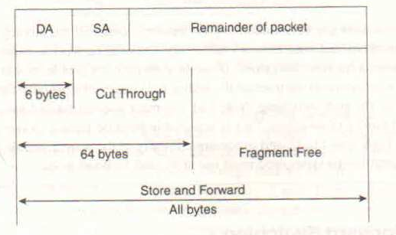
Switching mode
Store & forward
Cut through
Fragment free

Slide 16
Store & forward mode
Store & forward switches drop the errored frame
It has a variable latency
PPS= 1second/ ( IFG + Preamble + frame time )
IFG 12 Byte ,Preamble 8 byte , frame 64 byte or 1518 byte
PPS ( 64 byte frame )= 14880
PPS (1518 byteframe ) = 812

Slide 17
Cut through
It only waits for getting the destination address
This reduces latency ( time to receive 6 octet )

